Slide 1
Presentation on “ATTENDANCE SYSTEM”
KIST College & SS
Kamalpokhari Kathmandu
Submitted By:
Kshitiz GC
Manoram Subedi
MD Samsad Ali
Saroj Adhikari

Slide 2
Content:
Introduction
Purpose
Scope
Module Description of the project
Existing System
Proposed System
Technology & tools used
Advantages and Disadvantages
Limitations
Screenshot
Conclusion
Reference

Slide 3
Introduction:
In most Educational institutions attendance is taken manually. It is not only time consuming but also unreliable and it can be lost.
To overcome this problem we have developed web based attendance system.
Attendance System is software developed by daily student attendance in schools, college and institutions.
It facilitates to access the attendance information of a particular student in a particular class.
The information is sorted by the operators, which will be provided by the teacher for a particular class.
This system will also help in evaluating attendance eligibility criteria of a student.

Slide 4
Purpose:
The purpose developing attendance system is to computerized the tradition way of taking attendance.
Another purpose of developing attendance system is to generate the report automatically at the end of the session or in the between of the session.
Scope:
The scope of the project is the system on which the software is installed, i.e. the project is developed as a desktop application. And it will work for particular school, college and institute. But later on the project can be modified to operate it online.

Slide 5
Module Description Of The Project:
The system should be designed in such a way that only authorized people should be allowed to access some particular modules. The records should be modified by only administrators and no one else.
The user should always be in control of the application not the vice versa. The user interface should be consistent so that the user can handle application with ease and speed. The application should be conceptually clear.

Slide 6
Existing System:
The existing system is manual entry for students. Here the attendance will be carried out in the hand written registers. It will be a tedious job to maintain the record for the user. The human effort is more here. The retrieval of the information is not as easy as the records are maintained in the hand written registers. This application requires correct feed on input into the respective field. Suppose the wrong inputs are entered, the application resist to work so the user find it difficult to use.

Slide 7
Proposed System:
To overcome the drawbacks of existing system, the proposed system has been evolved. This project aims to reduce the paper work and saving time to generate accurate results from student’s attendance. The system provides with the best user interface. The efficient reports can be generated by using this proposed system.

Slide 8
Technology & Tools Used:
Programming Language C#
With .NET framework
Software Used : Windows 7 or Later

Slide 9
Advantages:
Easy access to all.
Easy analysis of data using database query.
Reduced workload on faculties.
Best user interface.
Efficient reports.
Less possibilties error.

Slide 10
Limitation:
This system called “Attendance system” is platform dependent.
Lack of secured data and security.
Online based application is not supported.
Lack some important features

Slide 11
Screenshots:

Slide 12
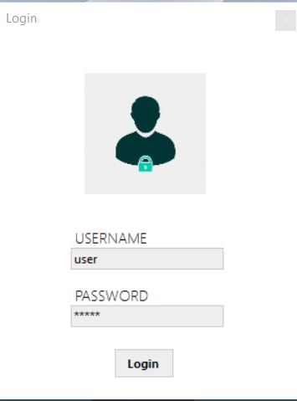
Login:

Slide 13
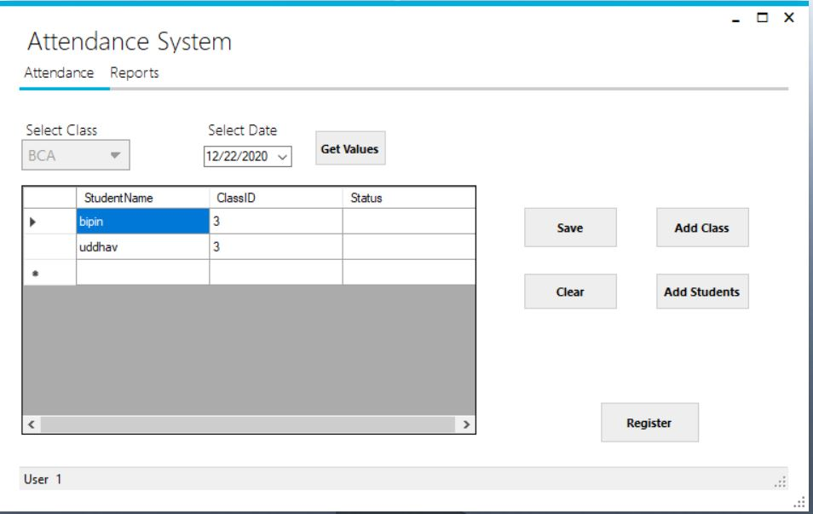
Student info:

Slide 14
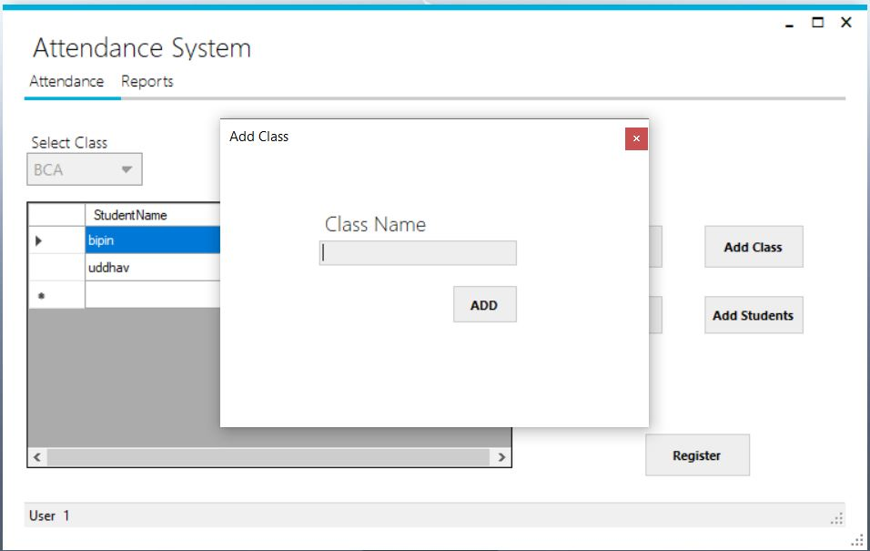
Add new class:

Slide 15
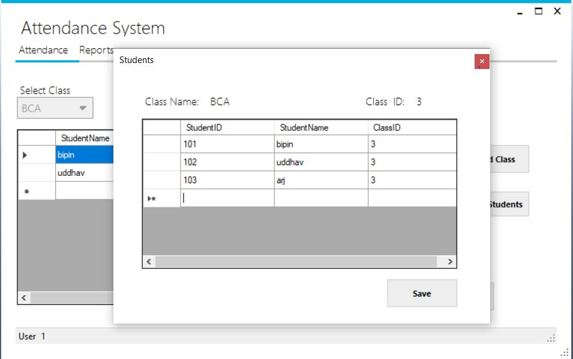
Add new student :

Slide 16
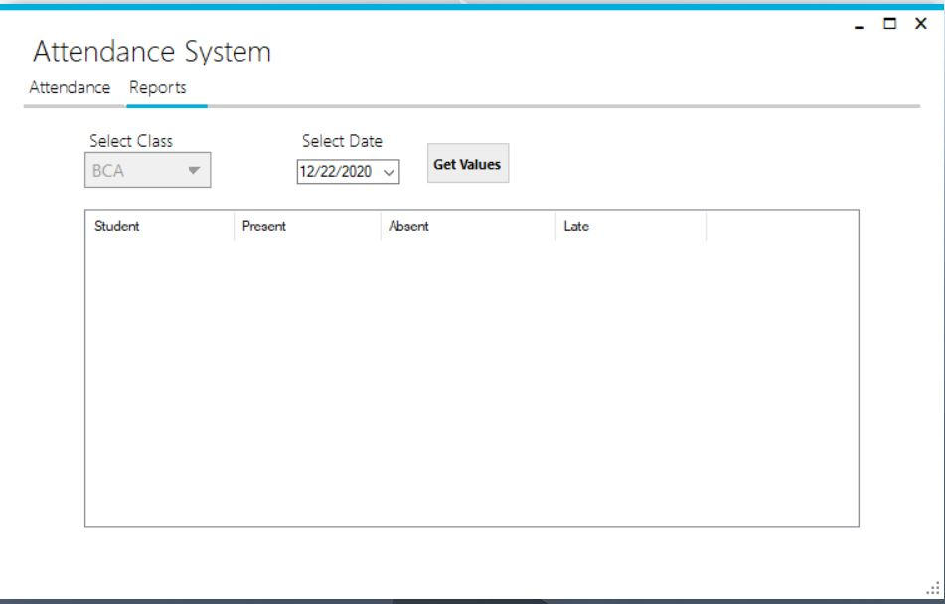
View Report :

Slide 17
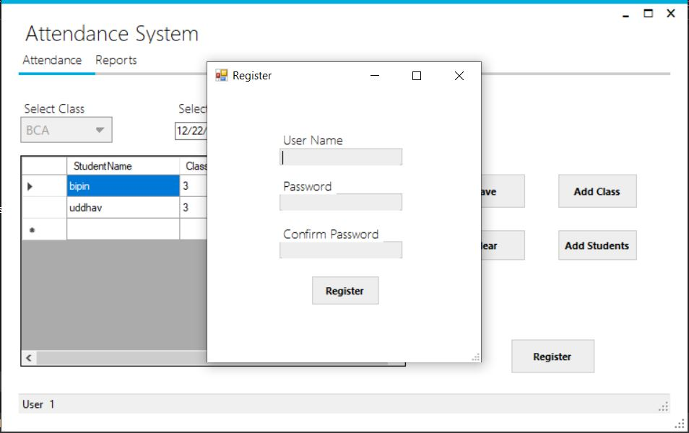
Register New User :

Slide 18
Conclusion of Project :
The attendance system developed by using C# and with .NET framework fully meets the objectives of the system which it has been developed. The system has reached a steady state where all bugs have been eliminated. The system is operated at a high level of efficiency and all the teachers and users associated with the system understand its advantages. The system solve the problem. It was intended to solve as requirement specification.

Slide 19
Reference:
SQl with C#, Klaus Elk
Visual C# 2012 How To Program, Paul Deitel & Harvey Deitel, Fifth Edition
Visual C# Programming - https://www.c-sharpcorner.com/csharp-tutorials
https://www.guru99.com/c-sharp-access-database.html

